Slide 1
HAEMA
BE IT 2027 Group 1

Slide 2
TEAM MEMBERS
Sr. No. | Student Name | Roll Number
1 | Yamin Khan | 242464
2 | Abdurrahman Qureshi | 242466
3 | Ruman Shaikh | 242479
4 | Sameer Shaikh | 242471
Project Guide | Er. Swati Ganar Gurav

Slide 3

INTRODUCTION
Blood, the petrol for humans is still searching for ways to reach its customer to fix their health.
Finding potential blood donors and locations to donate in urban metropolitan regions and rural areas is still bound to going to hospitals and requesting for blood.
In the worst case of blood black markets, a few litres is “sold” for thousands of rupees, meanwhile exploiting the someone's situation.
For individuals seeking to donate blood and those requesting for specific blood types, it becomes challenging to find their destination.

Slide 4
LITERATURE SURVEY
Paper | Findings | Year
Blood banking: The situation in India | India has ~4,000 blood centres collecting 12M units annually with 70% voluntary donations | 2012
Android Based Blood Donation Management System | Android app uses OTP verification, OCR authentication, and Firebase for secure real-time donor-requester matching | 2025
Study of Blood-transfusion Services in Maharashtra and Gujarat | Maharashtra has independent SBTC with better organization | 2009
Study of prevalence of ABO and Rhesus Blood groups in Voluntary Donors in Maharashtra | Most common blood groups: B+ (29.55%), O+ (28.33%), A+ (27.48%), AB+ (9.54%) | 2025
Blood Donation Application Using Machine Learning | ML-based app uses KNN, Random Forest, Logistic Regression to match donors and predict demand | 2024
Clinical demand and supply of blood in India | National demand: 14.6M units annually; supply gap ~1M units (2.5 donations per 1,000 persons) | 2022

Slide 5

RESEARCH GAPS
No real-time donor tracking and weak authentication
Blood banks cannot share inventory data with each other
Annual supply-demand gap of 1 million units
Insufficient component separation facilities across India
Low voluntary donation rates in rural and smaller cities
No AI/ML integration for demand prediction and donor matching
Missing OCR and OTP verification in existing donor apps
Lack of interoperability between blood banks for real-time inventory sharing

Slide 6

PROBLEM STATEMENT
Every day, trauma victims and obstetric patients require urgent blood transfusions, yet timely access remains elusive. Families navigate multiple hospitals, endure prolonged wait times, or resort to unregulated markets.
Existing applications lack robust authentication and AI-driven demand prediction. Blood banks operate in isolation without real-time inventory sharing or donor tracking.
This highlights the critical need for an online blood banking platform.

Slide 7

PROPOSED SOLUTION
The proposed solution is a cloud-based, interoperable platform connecting all blood banks, hospitals, donors, and recipients across India.
The system features real-time inventory tracking with critical alerts, demand requesting, donor matching using geolocation, and robust OTP/OCR-based authentication.
Additional capabilities include emergency SOS, gamification with rewards, interactive maps, smart notifications, admin dashboards, and a mobile-responsive PWA for rural access.

Slide 8
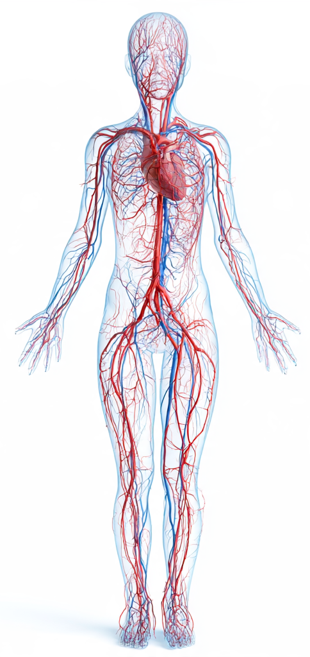
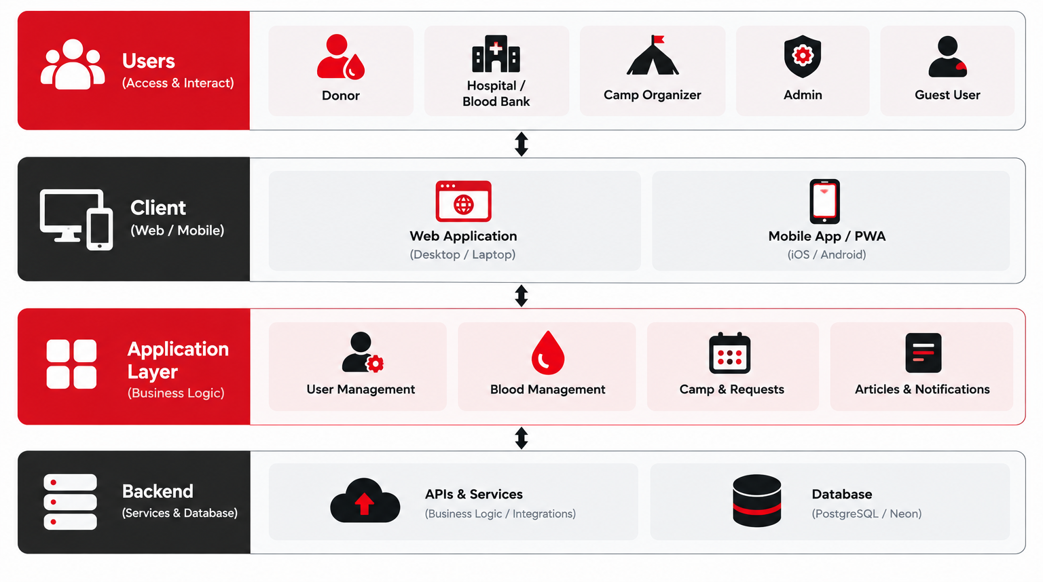
SYSTEM ARCHITECTURE

Slide 9












TECHNOLOGY STACK
Layer | Technologies
Frontend | NextJS, ShadCN, React.js, React Native, Flutter
Backend | Node.js, Express.js
Database | MongoDB Atlas
Cloud | AWS (EC2, S3, Monitoring), Vercel
API Testing | Postman, Jest, Supertest
Authentication and Security | Clerk, JWT, bcrypt, HTTPS, RBAC, Audit Logging
Maps and Notifications | Google Maps API, Firebase Cloud Messaging
Dev Tools | Git, GitHub, Postman, VS Code, NPM
Code Quality | ESLint, Prettier,

Slide 10
FUTURE SCOPE
AI-Based Blood Demand Prediction: Historical data, seasonal trends, and emergency patterns can be leveraged to forecast future blood requirements.
Smart Donor Matching: Suitable donors are automatically identified based on blood group, location, eligibility, last donation date, and availability.
Predictive Inventory Management: The system predicts low-stock situations and provides blood banks with alerts and restocking recommendations before shortages occur.
Advanced Analytics: Enables analysis of blood demand, donation trends, shortage patterns, emergency response times, and regional requirements.

